Slide 1
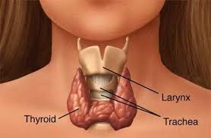
Hypothyroidism
Hyperthyroidism

Slide 2
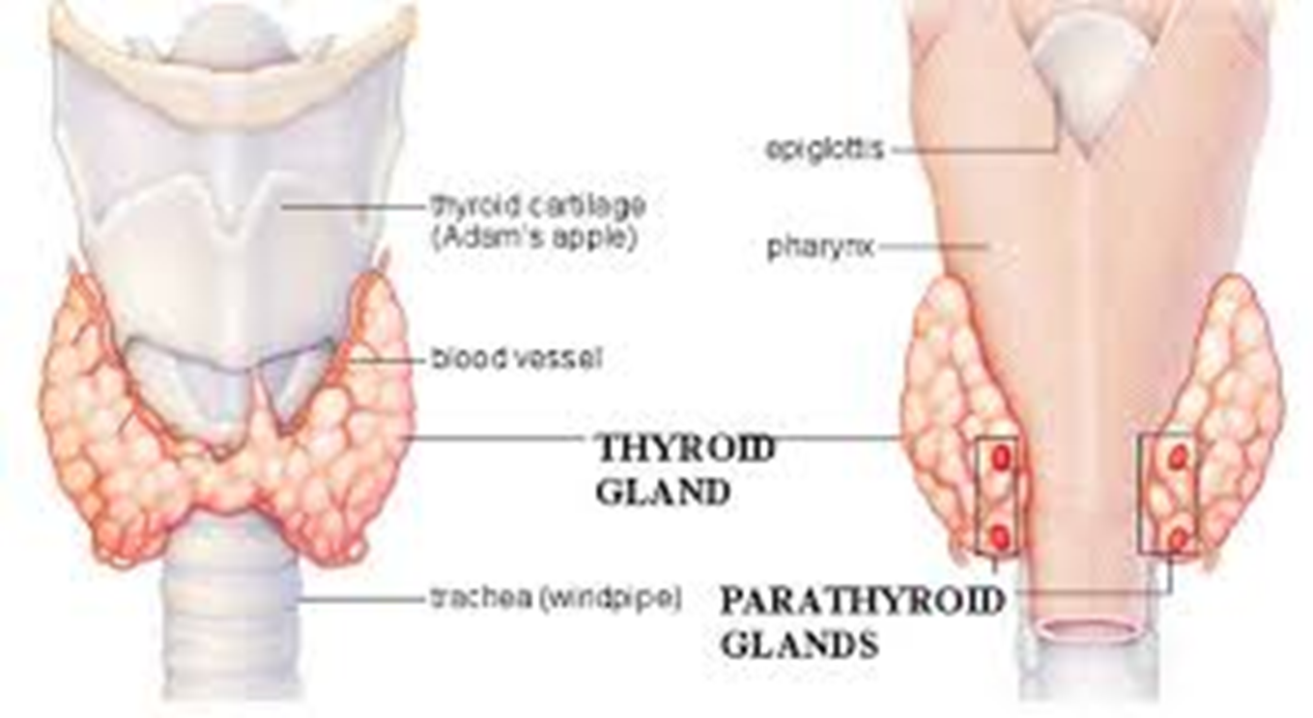
Thyroid Gland Anatomy

Slide 3
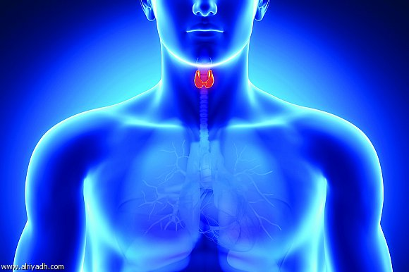
Nursing Care of Patients with Endocrine Disorders
Triiodothyronine (T3) and thyroxine (T4) are thyroid hormones secreted by the thyroid gland. These hormones may be collectively referred to as thyroid hormone (TH). Deficient secretion of TH results in hypothyroidism ; excess TH results in hyperthyroidism.
Hypothyroidism:
Hypothyroidism occurs primarily in women over 50 years old. If hypothyroidism occurs in an infant, severe problems with growth and development occur. This is why all babies born should be tested for hypothyroidism at birth.

Slide 4
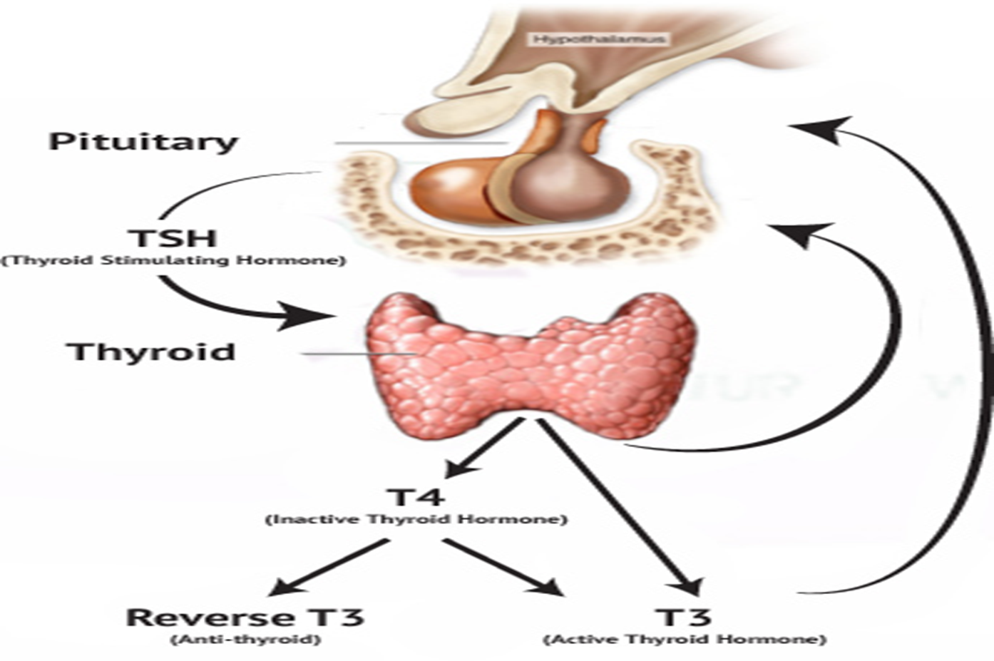
The Thyroid Gland physiology

Slide 5
Pathophysiology
1. Primary hypothyroidism occurs when the thyroid gland fails to produce enough TH even though enough thyroid stimulating hormone (TSH) is being secreted by the pituitary gland. The pituitary responds to the low level of TH by producing more TSH.
2. Secondary hypothyroidism is caused by low levels of TSH, which fail to stimulate release of TH.
3. Tertiary hypothyroidism results from inadequate release of thyrotropin-releasing hormone (TRH), secreted by the hypothalamus. Most cases of hypothyroidism are primary.
Because thyroid hormones are responsible for metabolism, low levels of these hormones result in a slowed metabolic rate, which causes many of the characteristic symptoms of hypothyroidism. Other symptoms are related to myxedema, which refers to a nonpitting type of edema that occurs in connective tissues throughout the body.

Slide 6
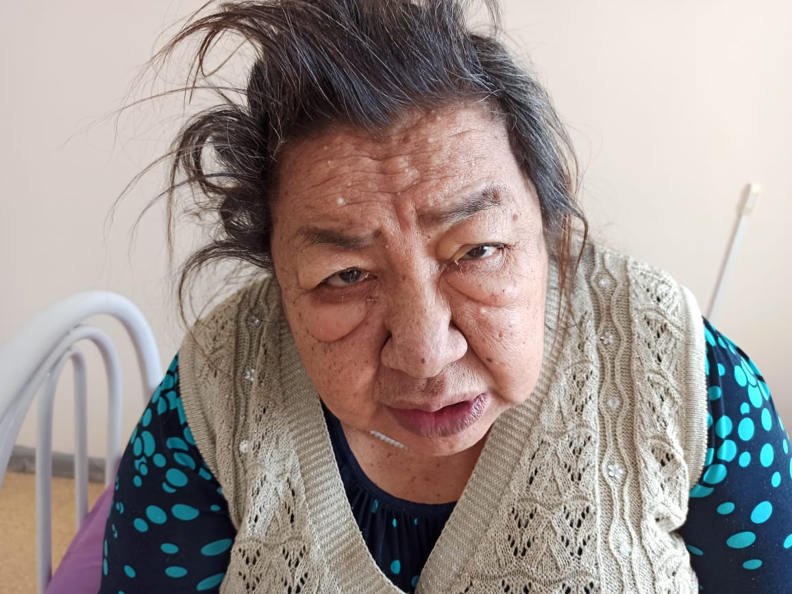

Slide 7
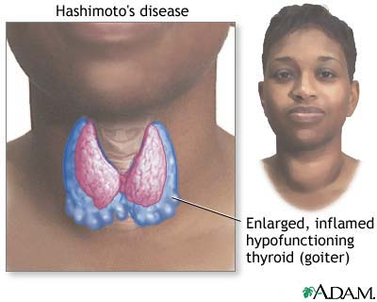
Etiology
1. Primary hypothyroidism may be a result of a congenital defect.
2. Inflammation of the thyroid gland, or iodine deficiency.
3.Hashimoto’s thyroiditis is an autoimmune disorder that eventually destroys thyroid tissue, leading to hypothyroidism.
4.Secondary or tertiary hypothyroidism may be caused by a pituitary or hypothalamic lesion or by postpartum pituitary necrosis, a rare disorder in which the pituitary is destroyed following pregnancy and delivery.
Signs and Symptoms
Manifestations are related to the reduced metabolic rate and include fatigue, weight gain, bradycardia, constipation, mental dullness, feeling cold, shortness of breath, decreased sweating, and dry skin and hair .
Heart failure may occur because of decreased pumping strength of the heart.
Altered fat metabolism causes hyperlipidemia, which can lead to cardiovascular disease.
In advanced disease, myxedema develops.

Slide 8
Complications for hypothyroidism
1. If the metabolic rate drops so low that it becomes life threatening, the result is myxedema coma. This usually occurs in patients with long-standing, untreated hypothyroidism and can be triggered by stress, such as infection, trauma, or exposure to cold. The patient becomes hypothermic, ↓ respiratory rate and depressed mental function and lethargy may occur.
2. Blood glucose drops. Cardiac output drops, which in turn can reduce perfusion of kidneys.
3. No pitting edema of the face, hands, and feet may develop.
4. Death can occur as a result of respiratory failure. If you note changes in mental status or vital signs, the physician should be contacted immediately.
5.Treatment of myxedema coma involves intubation and mechanical ventilation. The patient is slowly rewarmed with blankets. Intravenous levothyroxine (Synthroid) is given, and any underlying cause is treated.

Slide 9
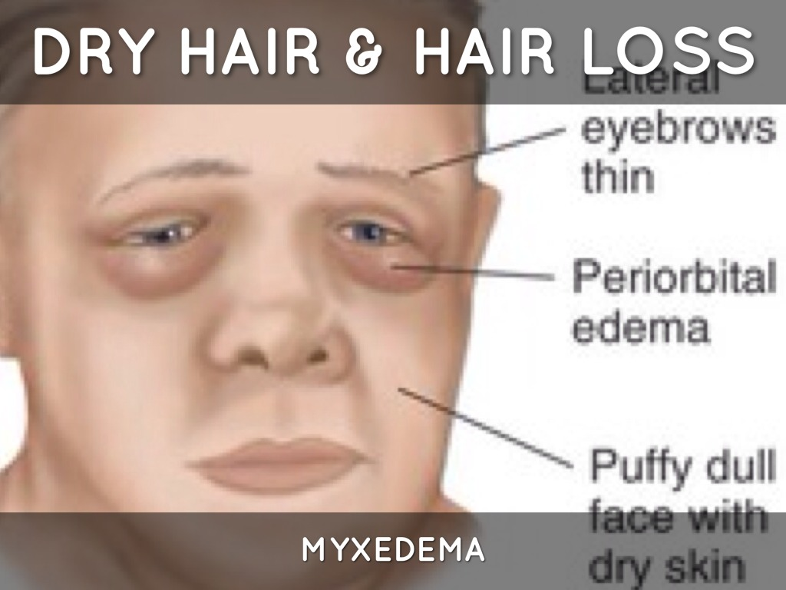
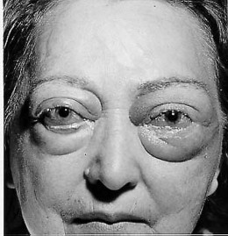
Myxedema

Slide 10
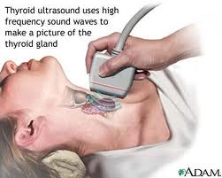
Diagnostic Tests:
1. The levels of T3 and T4 are low, and the level of TSH may be high or low, depending on the cause.
2. If the pituitary is functioning normally, TSH is elevated in an attempt to stimulate an increase in TH.
3. Serum cholesterol and triglycerides are elevated. Antibodies are usually present in autoimmune disease.
4. CT scan
Therapeutic Measures:
Primary hypothyroidism is easily treated with oral thyroid replacement hormone. Most patients now take synthetic thyroid hormone (levothyroxine [Synthroid]). Doses are started low and are slowly increased to prevent symptoms of hyperthyroidism or cardiac complications.
Patient Education:
1. Instruct the patient in the importance of consistent use of thyroid replacement medication and regular blood tests to monitor TSH.
2. The patient needs to be aware that too much thyroid hormone will cause symptoms of hyperthyroidism.

Slide 11
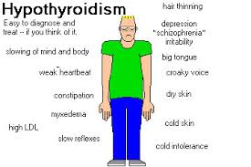
S & S of Hypothyroidism

Slide 12
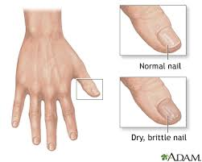
S & S of Hypothyroidism

Slide 13
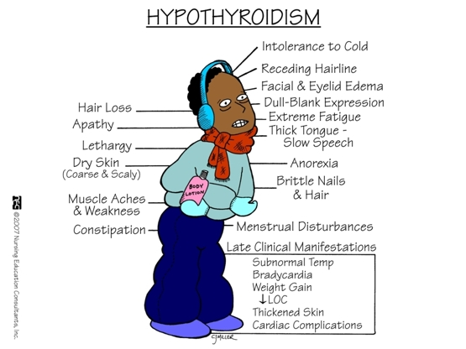
S & S of Hypothyroidism

Slide 14
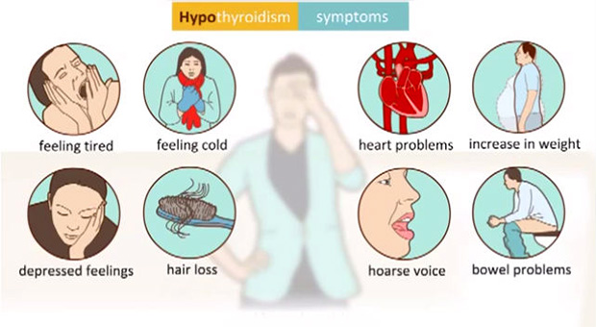

Slide 15
Hyperthyroidism:
Hyperthyroidism is most often diagnosed in young women. Graves’ disease, which is one cause of hyperthyroidism, is more common in young women. Multinodular goiter is more common in older women.
Pathophysiology:
Hyperthyroidism results in excessive amounts of circulating thyroid hormone (thyrotoxicosis). Primary hyperthyroidism occurs when a problem within the thyroid gland causes excess hormone release.
Secondary hyperthyroidism occurs because of excess TSH release from the pituitary, causing overstimulation of the thyroid gland.
Tertiary hyperthyroidism is caused by excess TRH from the hypothalamus. A high level of thyroid hormone increases the metabolic rate. It also increases the number of beta-adrenergic receptor sites in the body, which enhances the activity of norepinephrine. The resulting fight-or-flight response is the cause of many of the symptoms of hyperthyroidism.

Slide 16
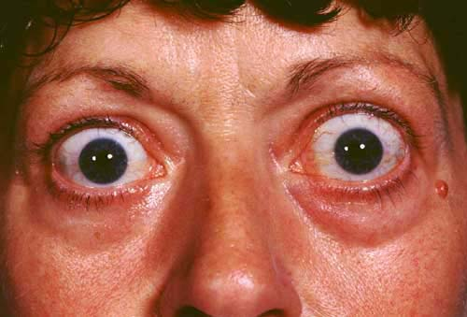
Hyperthyroidism

Slide 17
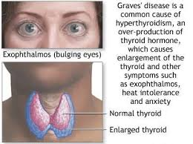

Slide 18
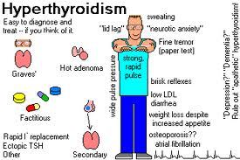

Slide 19
Etiology: A variety of disorders can cause hyperthyroidism.
1. Graves’ disease is the most common cause.
2. Autoimmune disorder in which thyroid-stimulating antibodies cause the thyroid gland to make too much thyroid hormone.
3. Other causes include thyroid nodules that secrete excess thyroid hormone (multinodular goiter and toxic adenoma).
4. Inflammation of the thyroid (thyroiditis), or a thyroid tumor.
5. A pituitary tumor can secrete excess TSH, which over stimulates the thyroid gland.
6. Patients taking thyroid hormone for hypothyroidism may take too much. Each of these problems can cause excess circulating TH and symptoms of hyperthyroidism.
7. Radiation exposure may predispose a patient to develop hyperthyroidism.
8. Heredity may also play a role in autoimmune hyperthyroidism. Women who smoke nearly double their risk of Graves’ disease.

Slide 20
Signs and Symptoms:
Many signs and symptoms are related to the hypermetabolic state, such as heat intolerance, increased appetite with weight loss, and increased frequency of bowel movements.
Nervousness, tremor, tachycardia, and palpitations are caused by the increase in sympathetic nervous system activity and may be more common in younger patients.
Heart failure can occur because of tachycardia and the resulting inefficient pumping of the heart. If treatment is not begun, the patient may become manic or psychotic.

Slide 21
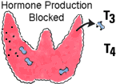
Complications:
Thyrotoxic Crisis: sometimes called (thyroid storm)is a severe hyperthyroid state that can occur in hyperthyroid people who are untreated or who develop another illness or stressor. It also may occur after thyroid surgery in patients who have been inadequately prepared with antithyroid medication.
Thyrotoxic crisis can result in death in as little as 2 hours if untreated. Symptoms include tachycardia, high fever, hypertension(with eventual heart failure and hypotension), dehydration, restlessness , and delirium or coma.

Slide 22
Hypothyoidism: Another complication of hyperthyroidism can be hypothyroidism. This can occur as a result of long-term disease or as a result of treatment. Patients with a history of hyperthyroidism should be monitored for recurrent hyperthyroidism or the onset of hypothyroidism.
Diagnostic Tests
1. Serum levels of T3 and T4 are elevated. TSH is low in primary hyperthyroidism
or high if the cause is pituitary.
2. A radioactive iodine uptake test or a thyroid scan can be done to determine hyperactivity of the gland or to locate a nodule or tumor.
3. The thyroid gland may be enlarged; palpation of the thyroid in a patient suspected to be hyperthyroid should only be performed by a physician. TSI (thyroid-stimulating immunoglobulin) is present in Graves’ disease

Slide 23

Therapeutic Measures:
Several medications can be used to treat hyperthyroidism. Propylthiouracil (PTU) and (Tapazole) inhibit the synthesis of TH, but they may take several months to be effective, and must be continued for 12 to 18 months.
Propranolol (Inderal) is a beta-blocking medication that relieves the sympathetic nervous system symptoms. High doses of oral iodine suppress the release of thyroid hormone.
Radioactive iodine (131I or RAI) may be used to destroy a portion of the thyroid gland. The patient takes one oral dose of RAI. Dietary iodine normally goes to the thyroid gland, where it is used to make thyroid hormone. When RAI is given, the radioactivity destroys some of the cells that make thyroid hormone.
Thyroidectomy can be done with a traditional, open approach, or with newer minimally invasive techniques that use a combination of a tiny incision and an endoscope. Patients can usually go home the same day, and have a faster recovery time with minimally invasive surgery.
The surgeon may choose to leave some of the thyroid gland intact, to continue to secrete some hormone.
Following surgery, the patient will likely be hypothyroid and will require thyroid replacement hormone (levothyroxine [Synthroid]).

Slide 24
Goiter
Definition: Enlargement of the thyroid gland is called a goiter.
Pathophysiology and Etiology:
The thyroid gland may enlarge in response to increased TSH levels, or sometimes in response to the autoimmune process that occurs in Graves’ disease.
TSH is elevated in response to low TH, iodine deficiency, pregnancy, or viral, genetic, or other conditions.
When a goiter is caused by iodine deficiency or other environmental factors, it is called an endemic goiter.
Some foods and medications are goitrogens. These substances interfere with the body’s use of iodine and include such foods as turnips, cabbage, broccoli, horseradish, cauliflower, and carrots .
Some goitrogenic medications include propylthiouracil, sulfonamides, lithium, and salicylates (aspirin). A goiter may be associated with a hyperthyroid, hypothyroid, or euthyroid state.
Goiter that occurs with hyperthyroidism is sometimes called a toxic goiter. Once the cause of the goiter is removed, the gland usually returns to normal size.

Slide 25
Signs and Symptoms:
The thyroid gland is enlarged, and swelling may be apparentat the base of the neck.
Alternatively, the gland may enlarge posteriorly, which can interfere with swallowing or breathing.
The patient may have a full sensation in the neck. Symptoms of hypothyroidism or hyperthyroidism may be present.
Diagnostic Tests:
Serum TSH, T3, and T4 levels are measured to determine thyroid function.
Ultrasound or a thyroid scan may be done to determine the cause or evaluate the size of the gland.
Therapeutic Measures:
Treatment is aimed at the cause. If goitrogens are suspected, the patient is given a list of foods to be avoided.
If iodine deficiency is a problem, it is added to the diet with supplements or iodized salt.
Hypothyroidism or hyperthyroidism is treated if indicated. Levothyroxine (Synthroid) may be given to reduce TSH levels via negative feedback.
Radioactive iodine therapy or thyroidectomy may be needed to treat hyperthyroid symptoms or if the enlarged gland is interfering with breathing or swallowing.

Slide 26
DIABETES MELLITUS
Diabetes mellitus is a group of metabolic diseases in which defects in insulin secretion or action result in elevated blood glucose (hyperglycemia).

Slide 27
Pathophysiology
Body tissues, and the cells that compose them, use glucose for energy. Glucose is a simple sugar provided by the foods we eat. When carbohydrates are eaten they are digested into sugars, including glucose, which is then absorbed into the bloodstream. Carbohydrates provide most of the glucose used by the body; proteins and fats can indirectly provide smaller amounts of glucose.
Glucose is able to enter the cells only with the help of insulin, a hormone produced by the beta cells in the islets of Langerhans of the pancreas. When insulin comes in contact with the cell membrane, it combines with a receptor that allows activation of special glucose transporters in the membrane. By helping glucose enter the body’s cells, insulin lowers the glucose level in the blood. Insulin also helps the body store excess glucose in the liver in the form of glycogen.
Another hormone, glucagon, is produced by the alpha cells in the islets of Langerhans. Glucagon raises the blood glucose when needed by releasing stored glucose from the liver and muscles. Insulin and glucagon work together to keep the blood glucose at a constant level.
Diabetes results from deficient production of insulin by the beta cells in the pancreas, or from inability of the body’s cells to use insulin. When glucose is unable to enter body cells, it stays in the bloodstream; hyperglycemia results, and the cells are denied their energy source.
Abnormal glucagon secretion may also play a role in type 2 diabetes.

Slide 28
Types and Causes:
Type 1 Diabetes Mellitus:
Type 2 Diabetes Mellitus.
Gestational Diabetes:
Other Types of Diabetes: Secondary diabetes
Type 1 diabetes (formerly called juvenile diabetes mellitus or insulin-dependent diabetes mellitus(IDDM) is caused by destruction of the beta cells in the islets of Langerhans of the pancreas. When the beta cells are destroyed, they are unable to produce insulin. Insulin must then be injected for the body to use food for energy. Only 5% to 10% of people with diabetes have type 1 diabetes.
It is believed that the pancreas may attack itself following certain viral infections or administration of certain drugs. This is called an autoimmune response. Almost 90% of patients newly diagnosed with type 1 diabetes have islet cell antibodies in their blood. These antibodies might be present for years before actual symptoms of diabetes develop. About 10% of people with type 1 diabetes cases also have a genetic predisposition to its development. The patient with type 1 diabetes is most often young and thin and is prone to develop ketoacidosis when blood glucose is elevated.

Slide 29
Latent Autoimmune Diabetes of Adulthood (LADA)
LADA is a variation of type 1 diabetes that has recently been identified. Some patients who were initially diagnosed with type 2 diabetes were later found to have islet cell and insulin antibodies (which are usually associated with type 1), and their blood glucose levels were not controlled with oral medications.
However, beta cell destruction tended to occur more slowly than with type 1 diabetes. This is possibly because of differences in the antibodies or the individual’s response to the antibodies.
Some experts distinguish patients with LADA as either thin or obese because the disorder has slightly different characteristics depending on the patient’s body fat.

Slide 30
Type 2 Diabetes Mellitus
Ninety to 95% of people with diabetes have type 2 diabetes mellitus (formerly called adult-onset diabetes mellitus or non-insulin-dependent diabetes mellitus (NIDDM).
In type 2 diabetes mellitus, tissues are resistant to insulin. Insulin is still made by the pancreas, but in inadequate amounts. Sometimes the amount of insulin is normal or even high, but because the tissues are resistant to it, hyperglycemia results.
As the disease advances, the pancreas eventually wears out and insulin production decreases. When this occurs, the patient will likely require insulin injections to control the blood glucose level.. Simply using insulin, however, does not make the person a type 1 diabetic.
Heredity is responsible for up to 90% of cases of type 2 diabetes.
Obesity is also a major contributing factor. Often the patient with a new diagnosis of type 2 diabetes is obese.

Slide 31
Gestational Diabetes:
Gestational diabetes mellitus (GDM) may develop during pregnancy, especially in women with risk factors for type 2 diabetes. The extra metabolic demands of pregnancy trigger the onset of diabetes.
Blood glucose usually returns to normal after delivery, but the mother has an increased risk for type 2 diabetes in the future. If the mother with GDM is overweight, she should be counseled that weight loss and exercise will decrease her risk of later developing diabetes. Mothers with GDM require specialized care and should be referred to an expert in this area.
Prediabetes
Pre-diabetes refers to blood glucose levels that are above normal but do not meet the criteria for diagnosing diabetes.
Pre-diabetes usually occurs before the onset of type 2 diabetes. It is diagnosed by evaluating fasting blood glucose levels, glucose tolerance tests. Those with prediabetes may be able to prevent the onset of diabetes with weight loss and exercise.

Slide 32
Other Types of Diabetes
1. Secondary diabetes may develop as a result of another chronic illness
that damages the islet cells, such as pancreatitis or cystic fibrosis.
2.Prolonged use of some drugs, such as steroid hormones, phenytoin ( Dilantin), thiazide diuretics, and thyroid hormone, may also impair insulin action and raise blood glucose.
3.Maturity-onset diabetes of the young (MODY) is an inherited defect in insulin secretion that usually occurs in individuals under the age of 25.
4. Less common causes include pancreatic trauma and other endocrine disorders.

Slide 33
Signs and Symptoms
Classic symptoms of diabetes mellitus include polydipsia (excessive thirst) , polyuria (excessive urination), and polyphagia (excessive hunger).
The large amount of glucose in the blood causes an increase in serum concentration, or osmolality.
The renal tubules are unable to reabsorb all the excess glucose that is filtered by the glomeruli, and glycosuria results. Large amounts of body water are required to excrete this glucose, causing polyuria, nocturia (nighttime urination) and dehydration.
The increased osmolality and dehydration cause polydipsia.
Because glucose is unable to enter the cells, the cells starve, causing hunger.
High blood glucose may also cause fatigue, blurred vision, abdominal pain, and headaches.
Ketones may build up in the blood and urine of patients with type 1 diabetes or late in the course of type 2 diabetes (ketoacidosis).

Slide 34
Diagnostic Tests:
1. Fasting Plasma Glucose Level: diagnosis of diabetes mellitus is based on plasma glucose levels measured by a laboratory test.
A normal plasma glucose level is less than 100 mg/dL. When the fasting plasma glucose (drawn after at least 8 hours without eating) is 126 mg/dL or greater, diabetes is diagnosed.
A second test may be required if the first test is not clearly diagnostic. If the fasting plasma glucose is between 100 and 125 mg/dL, the patient has impaired fasting glucose (IFG).
2. Casual Plasma Glucose:
Sometimes it is not feasible to check a fasting plasma glucose. A casual plasma glucose (CPG) is checked without regard to the last meal. Diabetes is diagnosed if the CPG is 200 mg/dL or greater, with symptoms of diabetes.

Slide 35
3. Oral Glucose Tolerance Test: another test to diagnose DM is the oral glucose tolerance test (OGTT). It is measures blood glucose at intervals after the patient drinks a concentrated carbohydrate drink. Diabetes is diagnosed when the blood glucose level is 200 mg/dL or greater after 2 hours. A result between 140 and 199 mg/dL at 2 hours leads to a diagnosis of impaired glucose tolerance (IGT).
4. Glycohemoglobin:
The glycohemoglobin test or (glycosylated hemoglobin, or HbA1c [hemoglobin A1C]) is used to gather baseline data and to monitor the progress of diabetes control. In 2009, the ADA also changed its guidelines to include the HbA1c as a diagnostic test for diabetes.
1. Glucose in the blood attaches to hemoglobin in the red blood cells. Red blood cells live about 3 months. When the glucose that is attached to the hemoglobin is measured, it reflects the average blood glucose level for the previous 2 to 3 months. This is a helpful measurement when blood glucose levels fluctuate, and a single measurement would be misleading. It also assists in determining the degree of effectiveness of a patient’s treatment plan. A normal HbA1c is 4% to 6%. An HbA1c of 6.5% or higher is diagnostic for diabetes. An HbA1c between 6% and 6.5% indicates high risk for developing diabetes.
2. Newer methods allow this test to be done in a physician’s office while the patient waits. Glycohemoglobin testing might be inaccurate in some people, such as those with anemia. These patients may instead be tested for glycated serum protein (also called fructosamine), which is a similar test that indicates glucose levels over a period of 1 to 2 weeks instead of 3 months.

Slide 36
5. Estimated Average Glucose
Some practitioners are using a new calculation to convert HbA1c results to estimated average glucose (eAG) numbers, which may be more meaningful to patients. The formula is 28.7 _ HbA1c – 46.7 = eAG Here is an example for a patient whose HbA1c is 8.6:28.7 _ 8.6 – 46.7 = 200.12, which can be rounded to 200 mg/dL
6. Additional Tests
Because diabetes affects so many body systems, additional tests recommended for baseline data include:
1. Lipid profile 2. Serum creatinine
3.Urine microalbumin levels to monitor kidney function
4.Urinalysis, and electrocardiogram.

Slide 37
Prevention
Although there is currently no known way to prevent type 1 diabetes, there are ways to prevent type 2 diabetes, it can prevent or delay the onset of diabetes with weight loss and regular exercise.
Losing as little as 5% to 10% of body weight through a half hour of exercise 5 days a week, and reducing fat and calories can reduce the risk of diabetes .
Therapeutic Measures
1. The only cure for diabetes is a pancreas (or islet cell) transplant. However, diabetes can be controlled.
2. Treatment begins with diet and exercise.
3. Insulin is added in patients with type 1 diabetes and insulin or oral hypoglycemic medication as needed in those with type 2 diabetes.
4. Blood glucose monitoring and education are also important to good diabetes control. To monitor the effectiveness of treatment, patients should have regular health care follow-up visits.

Slide 38
Goals of Treatment
The American diabetes association(ADA) recommends that patients maintain a preprandial (premeal) plasma glucose level of 70 to 130 mg/dL,
Peak postprandial glucose less than 180 mg/dL, and glycohemoglobin level of less than 7% to prevent or delay complications of diabetes.
Because of the risk for cardiovascular disease, they also recommend maintaining blood pressure of less than 130/80 mm Hg .
All goals may be adjusted in individual circumstances. For example, the patient who is unable to feel symptoms of hypoglycemia (low blood glucose) might have a higher preprandial glucose goal to prevent undetected hypoglycemic episodes.

Slide 39
Medical Nutrition Therapy
The goal of medical nutrition therapy (MNT) is to achieve and maintain blood glucose and lipid levels as near to normal as possible to prevent long-term complications.
1. For some, especially those with type 2 diabetes, weight loss and cholesterol and blood pressure control may be additional goals of nutrition therapy.
2. Because the patient with DM has a limited amount of insulin, either endogenous (from within the body) or injected, it is important to eat an amount of food that will not exceed the insulin’s ability to carry it into the cells. This requires a meal plan that includes consistent amounts of carbohydrates, proteins, and fats each day. Because carbohydrates contribute most to the blood glucose level, it is most important that the amount of carbohydrates consumed is consistent from one day to the next.

Slide 40
3. Eats a small amount of carbohydrate one day and a large amount the next, the blood glucose will fluctuate, leading to complications.
4. It is possible to relax nutrition restrictions somewhat if the patient is willing to test blood glucose frequently at home and adjust treatment accordingly. This requires in-depth instruction by a diabetes educator. The ADA recommends a complete assessment by a specially trained dietitian and an individualized nutrition therapy plan and teaching.
5. Various meal plans are available, Because diabetes increases the risk of high serum cholesterol and triglycerides, all plans limit fat intake.
6. Patients who use fat replacers (in foods such as fatfree baked goods or ice cream) should be aware that they still have food value and calories, so they cannot be considered “free” foods.
7. Most plans also encourage the use of complex carbohydrates such as whole grains, pastas, vegetables, and fruits. Simple sugars, which may raise blood glucose more than complex carbohydrates (they have a higher glycemic index), are used less but are not prohibited as they were in the past. Sodium intake is limited in individuals with hypertension.
8. Protein is limited in patients with any degree of kidney impairment. Any meal plan should be chosen to fit the patient’s lifestyle and food preferences. The success is evaluated by monitoring glucose levels, HbA1c, lipids, weight, blood pressure, and kidney function.

Slide 41
Exercise
Exercise is an important factor in controlling blood glucose and lipid levels. Exercise lowers blood glucose, both immediately and for approximately 24 to 48 hours after the exercise.
Insulin is not needed for glucose to enter exercising muscle cells. Exercise also improves blood lipid levels and circulation, which is important for the person with diabetes, who already has an increased risk of cardiovascular disease. Patients are instructed to exercise on a regular basis, ideally 30 minutes on most days of the week, to keep blood glucose levels stable and promote health.
Some patients with complications of diabetes must be careful in their exercise choices. For example, a patient with retinopathy should not do anything that causes straining.

Slide 42
8. A patient with neuropathy or foot problems should limit weight-bearing exercise. A physician or exercise physiologist should be consulted for an individualized exercise plan.
9. Persons with diabetes should always carry a quick source of sugar when exercising in case the blood glucose drops too low.
10. Individuals on intermediate-acting insulin are taught to avoid exercising at the time of day when their blood glucose is at its lowest point (i.e., when insulin or medication is peaking) and to have a carbohydrate snack before exercising if blood glucose is less than 100 mg/dL.
11. Exercising at similar times each day also helps prevent blood glucose fluctuations.
12. Patients should be cautioned to avoid exercise when their glucose level is higher than 250 mg/dL and ketones are present in the urine or if glucose is more than 300 mg/dL without ketones. This indicates that insufficient insulin is available and glycogen may be released during exercise, further increasing the serum glucose.

Slide 43
Medication
Injected Insulin
The person with type 1 diabetes has no endogenous insulin and therefore must administer insulin daily..
Problems requiring insulin adjustment (Two problems that can occur with glucose control are the Somogyi effect and the dawn phenomenon)
The Somogyi effect may be at fault when the patient’s blood glucose seems to be rising in spite of increasing insulin doses. If insulin levels are too high, the blood glucose may drop too low, stimulating release of counter regulatory hormones (epinephrine, glucagon, corticosteroids, growth hormone), which then elevate the blood glucose. The low glucose levels often occur during the night, and the patient may report night sweats or morning headaches. The high morning glucose is then interpreted as hyperglycemia, and the insulin dose may be further increased, compounding the problem.

Slide 44
The dawn phenomenon is thought to occur because of the natural release of growth hormone and cortisol during the early morning hours. This causes hyperglycemia on arising in the morning. The patient might be asked to monitor blood glucose between 2 a.m. and 4 a.m. in addition to bedtime and morning testing to assess whether the Somogyi effect or the dawn phenomenon is occurring. Correction of the Somogyi effect involves reducing the insulin dose. The Dawn phenomenon is treated with careful adjustment of meals and insulin so that insulin is peaking when the blood glucose is highest.

Slide 45
Oral Hypoglycemic Medication :
The patient with type 2 diabetes may be able to control blood glucose levels with medical nutrition therapy and exercise alone.
If needed, oral hypoglycemic medication or insulin will also be prescribed. Oral hypoglycemics are not insulin pills, but rather work in ways such as stimulating the pancreas to produce more insulin, or making the tissues more sensitive to insulin. Remember that if insulin is ingested, it is digested, because it is a protein. Because most oral hypoglycemic agents depend on at least a partially functioning pancreas, most are not useful for patients with type 1 diabetes.
Most insulins and oral hypoglycemics should be administered before meals.
Care should be taken to prevent passage of more than 30 minutes between medication administration and the meal because this may result in a hypoglycemic episode. Some must be taken with, rather than before, meals.
Check individual drugs for specific timing.
If the blood glucose level is not controlled with an oral hypoglycemic agent, insulin may be needed for the person with type 2 diabetes. This does not mean the person has type 1 diabetes. Insulin may be needed to control blood glucose but, unlike in the person with type 1 diabetes, insulin is not needed to sustain life.

Slide 46
Other diabetic medication
A novel medication is exenatide (Byetta), an injectable drug that was first isolated in the saliva of the Gila monster! It is an “incretin mimetic,” meaning it mimics natural incretins in the body.
Incretins are hormones secreted by the gastrointestinal (GI) tract that stimulate insulin release in response to nutrients in the intestine. Byetta works in conjunction with oral hypoglycemic agents, and stimulates insulin secretion, lowers production of glucagon, slows gastric emptying, and promotes weight loss.
Another newer drug, pramlintide (Symlin), is an injectable agent that is used with insulin. It is a synthetic analog of amylin, a naturally occurring hormone that reduces glucose levels following meals. It may also promote weight loss in individuals who are overweight. Patients using Symlin have an increased risk of hypoglycemia.

Slide 47
Self-Monitoring of Blood Glucose
1. Self-monitoring of blood glucose (SMBG): usually is done before meals and at bedtime by the person on insulin who wants to maintain tight control of blood glucose. Less frequent schedules may be prescribed for patients who are unable or unwilling to test four times a day or for patients not on insulin. Some may test before breakfast and supper, and some may vary testing times from day to day. Patients are also often recommended to periodically test 2 hours after meals..
2. Urine Glucose and Ketone Monitoring:
Urine also may be tested for glucose and for ketones. Urine glucose testing was done routinely before the development of SMBG. A variety of dipsticks and tape products are available for urine testing. If glucose appears in the urine, the patient is warned that the blood glucose is elevated, but the actual level is unknown. Most people have glucose in their urine when their blood glucose is more than about 180 mg/dL. It is difficult to base treatment on urine glucose levels, and so routine urine testing for glucose is no longer recommended.
Urine should be tested for ketones during acute illness or stress, when blood glucose levels are consistently above 300 mg/dL, during pregnancy, or when symptoms of ketoacidosis are present. If ketones are present, the patient knows an insulin deficiency is present and should notify the physician. Patients with type 1 diabetes are most at risk for developing ketoacidosis; however, it is wise for the patient with type 2 diabetes to test for ketones if risk factors are present.

Slide 48
Complication of Diabetes
A. Acute Complications of Diabetes
A person with diabetes is at risk for a variety of complications. Acute complications related to high and low blood glucose levels are treatable and can often be prevented with appropriate care.
1. Hyperglycemia:
When calories eaten exceed insulin available or glucose used, high blood glucose(hyperglycemia) occurs.
A common cause of hyperglycemia is eating more than the meal plan prescribes.
Another major cause is stress. Stress causes the release of counter regulatory hormones, including (epinephrine, cortisol, growth hormone, and glucagon). These hormones all increase the blood glucose level. In a person without diabetes, this is an adaptive function. However, the patient with diabetes is unable to compensate for the increased blood glucose with increased insulin secretion, and hyperglycemia results.

Slide 49
Patients must be able to recognize signs and symptoms of high blood glucose levels and know what to do if they occur . For many patients, these are similar to the symptoms they experienced when they were first diagnosed with diabetes. Chronic high blood glucose levels can lead to long-term complications.
B. Hypoglycemia
Low blood glucose, or hypoglycemia, occurs when there is not enough glucose available in relation to circulating insulin. This is sometimes referred to as an insulin reaction. Hypoglycemia is usually defined as a blood glucose level below 50 mg/dL, although patients may feel symptoms at higher or lower levels. Occasionally, symptoms occur as a result of a rapid drop in blood glucose, even though the actual glucose level is normal or high.
Causes of hypoglycemia
1. It may include skipping a meal,
2. Exercising more than usual,
3. Accidentally administering too much insulin. Repeated or extremely low blood glucose levels can cause neurologic damage because there is not enough glucose for brain function. It is therefore important to teach patients how to prevent and treat low blood glucose

Slide 50
Symptoms of low blood glucose
1. Hunger, sweating, pallor, tremor, palpitations, and headache. These symptoms are caused by activation of the sympathetic nervous system. As hypoglycemia progresses, the brain is deprived of glucose (called neuroglycopenia) and neurologic symptoms such as irritability, confusion, seizures, and coma may occur. If you find someone with symptoms of altered blood glucose but are unable to identify whether it is high or low, do a blood glucose test. However, if the patient has neurologic symptoms, treat for low blood glucose immediately.
2. The blood glucose may then be checked and further treatment provided as indicated.
3. Recheck the blood glucose in 15 minutes. If it does not return to at least 70 mg/dL, repeat the procedure every 15 minutes until 70 mg/dL is reached-even if the patient is feeling better.

Slide 51
Diabetic Ketoacidosis
Pathophysiology :
Diabetic ketoacidosis (DKA) occurs when blood glucose levels become very high and insulin is deficient. This most commonly occurs in people with type 1 diabetes, but it may occur in type 2 diabetes when insulin deficiency exists. DKA symptoms are often the reason a person with undiagnosed type 1 diabetes first seeks help. It may also be the result of stress or illness in a person with previously diagnosed type 1 (or rarely, type 2) diabetes.
When there is insufficient insulin to allow glucose into cells, the cells starve. The body then breaks down fat to be used for energy. The fat breakdown releases an acid substance called ketones. As ketones build up in the blood, ketoacidosis occurs.
The body attempts to compensate for acidosis by deepening respirations, thereby blowing off excess carbon dioxide. The deep, sighing respiratory pattern is called Kussmaul’s respirations. The expired air has a fruity odor caused by the ketones and may be mistaken for alcohol. Some nurses have likened the odor to Juicy Fruit chewing gum. With such high blood glucose and the accompanying polyuria, the body becomes dehydrated very quickly. Tachycardia, hypotension, and shock can result. Acidosis also causes potassium to leave the cells and accumulate in the blood (hyperkalemia). Potassium is then lost in large amounts in the urine, which can lead to hypokalemia. The combination of dehydration, potassium imbalance, and acidosis causes the patient to develop flu-like symptoms, including abdominal pain and vomiting. The patient loses consciousness and death occurs if DKA is not treated. The mortality rate for DKA can be up to 10%.

Slide 52
Therapeutic Measures : Treatment includes IV fluids, IV insulin, and blood glucose monitoring, often initially in an intensive care unit (ICU) setting. Glucose is added to the IV when the blood glucose drops to about 180 mg/dL to avoid hypoglycemia. Potassium should also be monitored closely, since it is essential to have normal levels for cardiac function. Arterial blood gases help monitor acidosis. The cause of the DKA should be identified and treated.
Prevention of ketoacidosis involves careful monitoring of blood glucose levels at home. Teach patients to use a urine dipstick to check for ketones (Ketostix) if blood glucose rises above 300 mg/dL. If ketones are present, the patient should drink water and recheck with the next urination. If ketones are still present, the physician should be notified. Instruct patients to never stop their insulin without a physician’s supervision.

Slide 53
Hyperosmolar Hyperglycemia
Pathophysiology: (also called hyperosmolar hyperglycemic non-ketotic syndrome, or HHNK) occurs mainly in type 2 diabetes, when blood glucose levels are high as a result of stress or illness.
Because the person with type 2 diabetes has some insulin production, cells do not starve and DKA usually does not occur. Hyperosmolar hyperglycemia occurs more often in hyperosmolar (concentrated) state. Blood glucose may rise as high as 1500 mg/dL, and electrolyte imbalances occur. Because ketoacidosis is not present, the patient may not feel as physically ill as the patient with DKA and may delay seeking treatment. Symptoms of hyperosmolar hyperglycemia develop slowly and include extreme thirst, lethargy, and mental confusion. Shock, coma, and death occur if it is left untreated.
The mortality rate for hyperosmolar hyperglycemia is between 10% and 20%.

Slide 54
Theraputic measures : Treatment includes IV fluids and insulin, and glucose monitoring. Electrolytes are closely monitored. The cause of hyperosmolar hyperglycemia should be identified and treated. Hyperosmolar hyperglycemia can be prevented with careful monitoring of glucose levels at home. Instruct patients to drink plenty of fluids if blood glucose levels are beginning to rise, especially in times of stress and illness. They should also know when to call their physician with high blood glucose results.
B. Long-Term Complications:
Over time, chronic hyperglycemia causes a variety of serious complications in persons with diabetes. These involve the circulatory system, eyes, kidneys, skin, and nerves. Most of the complications involve either the large blood vessels in the body (macrovascular complications) or the tiny blood vessels, such as those in the eyes or kidneys (microvascular complications).

Slide 55
Macrovascular Complications
Circulatory system: People with diabetes develop atherosclerosis and arteriosclerosis faster than the general population. They are more likely to have hypertension and elevated low-density lipoprotein (LDL) cholesterol and triglyceride levels.
High blood glucose also may affect platelet function, leading to increased clotting. These problems lead to a higher incidence of strokes, heart attacks, and poor circulation in the feet and legs.
The risk of cardiovascular disease and strokes is two to four times more common in persons with diabetes than in the general population.
Control of blood glucose, blood pressure, and cholesterol levels is vital to help prevent these deadly complications. Patients should also avoid smoking, maintain normal weight, and exercise regularly.
All patients should be evaluated for treatment with aspirin or other antiplatelet medication, angiotensin-converting enzyme (ACE) inhibitor therapy, and statin therapy for control of blood lipids.

Slide 56
Microvascular Complications
1.Eyes: Small blood vessels can become diseased, eventually leading to retinopathy in most patients with diabetes.
2. Retinopathy involves damage to the tiny blood vessels that supply the eye. Small hemorrhages occur, which can cause blindness if not corrected. Diabetes is the leading cause of blindness in adults .Newer laser surgery techniques may help improve vision after hemorrhages occur. Diabetes is also associated with a high incidence of cataracts. Patients with diabetes should have a yearly dilated eye examination.
3. Kidneys : Nephropathy is caused by damage to the tiny blood vessels within the kidneys. Up to 40% of patients with diabetes develop some degree of nephropathy. A primary risk factor for diabetic nephropathy is poor control of blood glucose. If nephropathy occurs, the kidneys are unable to remove waste products and excess fluid from the blood. Routine urine tests are done to check for microalbuminuria (tiny amounts of protein in the urine) or microalbumin-tocreatinine ratios. If microalbuminuria occurs, a low-protein diet may help delay further development of nephropathy.

Slide 57
4. Nerve Complications: Another complication of diabetes is neuropathy, which is damage to nerves as a result of chronic hyperglycemia. Neuropathy can cause numbness and pain in the extremities, erectile dysfunction (impotence) in men, sexual dysfunction in women.
5.Gastroparesis (delayed stomach emptying), and other problems. Unfortunately, pain caused by neuropathy is difficult to treat with traditional analgesics. Some antidepressant and anticonvulsant drugs may be helpful, and in some cases local injections of anesthetics may be used.
6.Infection: Persons with diabetes are prone to infection for several reasons. If injuries occur, healing may be slow because of impaired circulation. There may not be enough blood supply to heal the wound or fight an infection. For the same reason, it may be difficult for IV antibiotics to reach an infected site, and topical antibiotics may be preferable. In the presence of hyperglycemia, white blood cells become sluggish and ineffective, further reducing the body’s ability to fight infection. The incidence of periodontal (gum) disease, caused by bacteria in plaque, is also increased in individuals with diabetes. Patients must be taught to maintain good oral hygiene and make regular visits to the dentist.

Slide 58
7.Foot Complications: The combination of vascular disease, neuropathy, and risk for infection makes patients with diabetes prone to foot problems. Consider the patient who has no feeling in his or her feet because of neuropathy. If the patient steps on a tack, it may not be felt right away. Vascular disease will prevent a good blood supply from preventing infection and promoting healing. If infection sets in, it is slow to resolve and may progress to necrosis and gangrene. Pressure points on the feet may also break down. One woman had a Bic pen in her shoe all day and did not realize it! Neuropathy can also lead to deformities of the feet, further increasing the risk of injuries.
For these reasons, diabetes is the leading cause of non-traumatic amputation of the lower extremities .Teach patients to protect their feet at all times by wearing well-fitting shoes and by washing, drying, and inspecting their feet daily . If any sores are noted, the patient should not delay in seeking treatment.
During routine visits to the physician, teach the patient to be sure to remove shoes and socks so feet can be thoroughly examined. The physician or diabetes specialist can test sensation in the feet with tiny filaments. Loss of protective sensation is an early risk factor for amputation, so any reduction in sensation is a warning sign that extra care must be taken. A podiatrist (foot doctor) can be consulted if problems occur.

Slide 59
Foot Care:
1. Wash and dry feet every day. Use warm (not hot) water to avoid burns.
2. Apply lotion that does not contain alcohol, avoiding areas between toes.
3. Inspect feet for sores or red areas daily (have a family member help if necessary).
4. Report any abnormalities immediately.
5. Wear leather shoes and white or light-colored cotton socks.
6. Never go barefoot.
7. Avoid garters and tight socks.
8. Avoid crossing legs.
9. Cut toenails to natural shape of nail—not into corners.
10. See a podiatrist for calluses or problem toenails (avoid “bathroom surgery”).
11. Have feet checked at least once a year, preferably three to four times a year, for loss of sensation.

Slide 60
Diabetes Self-Management Education
1. The individual with diabetes must receive diabetes self management education (DSME) if at all possible. No amount of care from a physician or nurse can replace the self-care required of the person with diabetes. The involvement of family or significant others is also important for the successful treatment and well-being of the person with diabetes.
2. If the patient is hospitalized at diagnosis, the initial instruction is done in the hospital. However, hospital stays are so short, you cannot waste any time. Begin assessing baseline knowledge and teaching as soon as the patient is feeling physically well enough to learn. Depending on your state nurse practice act, this may be the responsibility of the primary or registered nurse, although aspects of the instruction may be delegated to the nurse. Generally this encompasses “survival skills,” which include the basic information the patient needs initially to survive at home.
3. Survival skills include medication administration, glucose monitoring, meal plan basics, and what to do if high or low blood glucose levels occur. A variety of helpful aids, such as pamphlets and videos, are available. Diabetes equipment suppliers provide kits that are full of samples and information. These are a significant help when you are teaching a patient.

Slide 61
4. Also advise the patient to purchase a medical alert bracelet or necklace. It is difficult to know how to operate and teach glucose monitoring with the variety of glucose monitors available.
5. Many drug stores and medical supply stores not only sell the monitors but also provide training for the patient and family. You can obtain this information by calling local medical suppliers or by contacting the diabetes educator or discharge planner at your institution.
6. After discharge, the patient should be referred to outpatient diabetes classes for further instruction. If classes are unavailable or if the patient is unable to leave home, a referral to a visiting nurse should be made. It is usually advisable to have a nurse present for the patient’s first insulin injection at home.

Slide 62
The ADA recommends that DSME include information about the following:
• Disease process and treatment options.
• Nutritional management.
• Incorporating physical activity into lifestyle
• Using medications safely.
• Monitoring blood glucose and using results
• Preventing, detecting, and treating acute complications
• Preventing, detecting, and treating chronic complications
• Personal strategies for psychosocial adjustment.
• Personal strategies for health promotion and behavior change.
•Because many people with diabetes are elderly, it is important to be aware of their special needs.

Slide 63
Reactive hypoglycemia
Occurs when the blood glucose drops below a normal level, usually below 70 mg/dL. Hypoglycemia is most often a complication of diabetes treatment, but at times it may occur without the presence of diabetes. It may be a warning sign of impending diabetes.
Pathophysiology and Etiology: Low blood glucose may occur as an overreaction of the pancreas to eating. The pancreas senses the blood glucose level rising and produces more insulin than is necessary for the use of that glucose. As a result, the blood glucose drops to below normal. It may be due to abnormally low levels of glucagon, or alternatively, it may be due to high levels of insulin. Some experts believe that this is a rare condition and that many “hypoglycemic” episodes are due to activation of the sympathetic nervous system for other reasons, without true hypoglycemia.
Signs and Symptoms
1. Low blood glucose causes release of epinephrine, which in turn causes the blood glucose to rise.
2.Epinephrine release causes a fight-or-flight reaction, which may produce shaking, sweating, and palpitations.
3. Headache, chills, and confusion may also occur.
Symptoms are the same as those described earlier related to hypoglycemia in diabetes.

Slide 64
Diagnosis:
1. Diagnosis is often based on a 5-hour glucose tolerance test, with below-normal readings between 2 and 5 hours. However, with the availability of home glucose monitors, it is now preferable for patients to monitor blood glucose levels at home.
2. Readings should be taken in the morning on arising, 2 hours after each meal, at bedtime, and during symptoms of hypoglycemia. These results may then be taken to the physician for interpretation.
Therapeutic Measures
1. Treatment includes frequent small meals and avoidance of fasting.
2. Simple sugars are avoided because they may aggravate symptoms.
3.High-fiber foods, complex carbohydrates, and proteins are recommended.

Slide 65
شكرا لكم على حسن الاستماع

